Slide 1
Managing a Public Pension Plan: One Approach
TLFFRA Educational Conference
October 4, 2022
Lakeway, TX
David Wescoe, Executive Director
Texas Municipal Retirement System

Slide 2
Like the U.S. Government, a Pension Plan Is…
“An insurance company with an army.”
Peter R. Fisher, Under Secretary of the U.S. Treasury, 2002

Slide 3
Or, Chipotle and Goldman
+

Slide 4
All Plans Perform the Same Fundamental Functions
Keep Member data fresh (the “ingredients”),
Calculate the correct benefit (the “customer’s order”), and
Deposit the benefit check every months (the “burrito bowl”)
Invest the money
AND

Slide 5
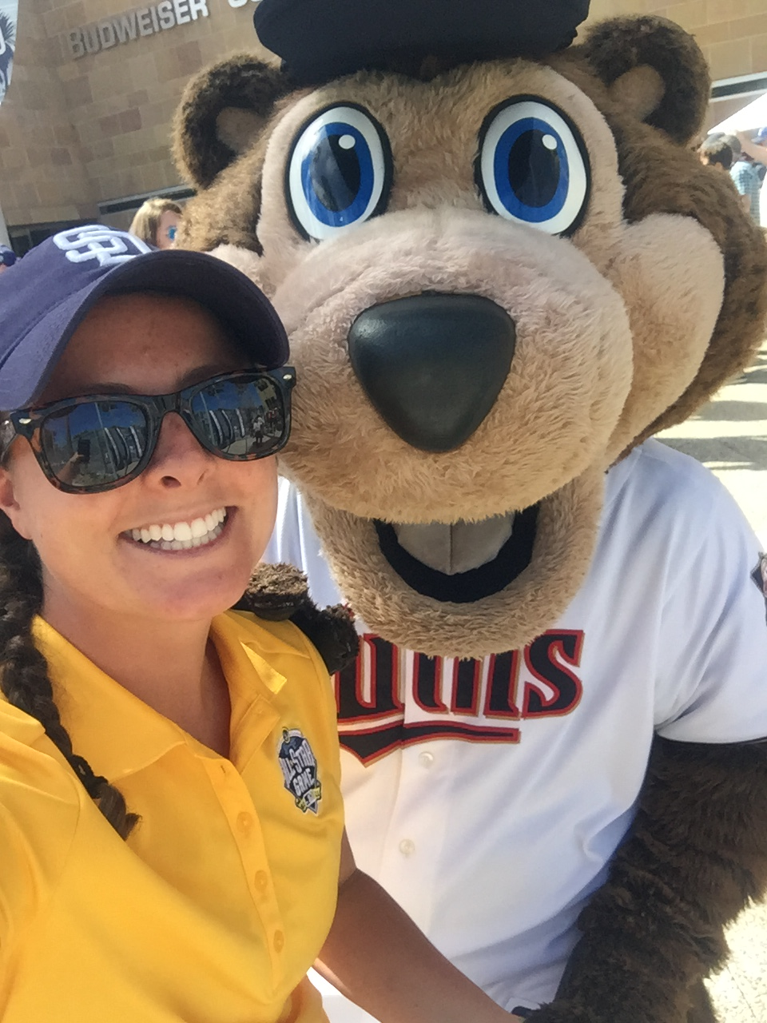
Provide Great Member Service

Slide 6
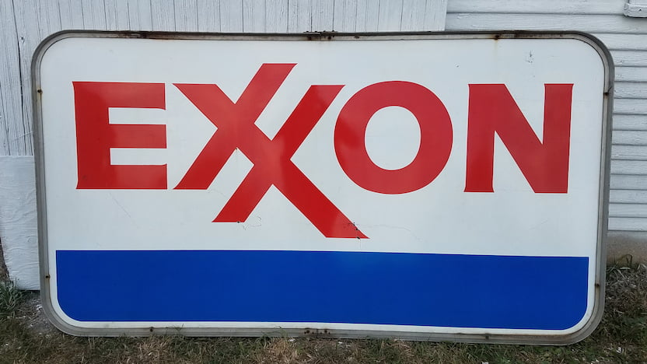
Right People in the Right Spot

Slide 8
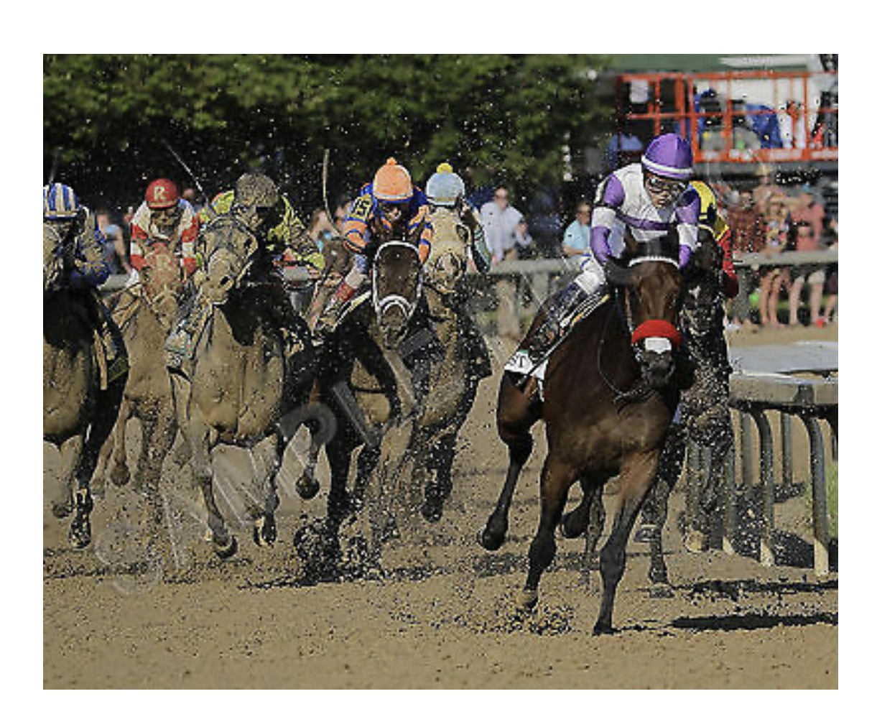
A Clear Vision

Slide 9
The Reward

Slide 10
Board Governance

Slide 11
“Good Boards don’t create good companies, but a bad Board will kill a company every time.”

Slide 12
A Typical Trustee Profile
“Pension boards are lay boards, and their trustees are mostly part-time volunteers”
Trustees “represent various constituencies: elected, appointed and ex officio…”
“[Trustees are not] typically investment or pension administration experts…”
“[Trustees] usually don’t have the time to be involved in day-to-day management”
“The Role of the Fiduciary Board,” Rick Funston, CEO, Funston Advisory Services

Slide 13
“Gee, I didn’t think of that.”

Slide 14
100:1

Slide 15
Therefore, Trustees Should…
“Rely on their professional staff and independent advisors for guidance, execution and verification,”
Understand that their role “is one of oversight, not close supervision or in involvement in day-to-day management,” and
“Delegate operations to executives, staff and consultants while maintain oversight controls.”
“The Role of the Fiduciary Board,” Rick Funston, CEO, Funston Advisory Services

Slide 16
In Other Words…
Trustees should leave the muffins to management.

Slide 17
A Trustee’s Most Important Role Is…
To fulfill their and the plan’s fiduciary duty to plan Members

Slide 18
Trustee Fiduciary Duties Are Clear
Act loyally and impartially in the best interests of Members and beneficiaries
Be prudent by exercising care, skill and diligence
Stay informed and aware
Diversify assets and control costs
Comply with the law
Don’t turn a blind eye to misdeeds of other fiduciaries
“Five Keys to Improving Board Effectiveness in Public Retirement Systems,” Funston and Lukomnik

Slide 19
Two Current Fiduciary Challenges
Legislative
Political

Slide 20
Fossil Fuel Investments

Slide 21
Proxy Voting
CalPERS believes that owning company shares and voting proxies can be more impactful than divestment:
“[If we divest] we will not have a seat at the table, and our seat will be taken by investors that may not have the same interest in long-term sustainability as CalPERS.”
Dan Brown, Chief, CalPERS Legislative Affairs Division

Slide 22
Proxy Voting cont.
MOSERS is modifying its proxy rules after the State Treasurer (who is also a MOSERS Trustee) sought to “protect” the fund from “being used by activist investment managers to advance left-wing social and political causes.”

Slide 23
The Power of One

Slide 24
And if These Issues Aren’t Complicated Enough…
…there’s one more challenge

Slide 25
Trustees Must Do It All in Public

Slide 26
Thank You

