Slide 1
Due Diligence and Your Fiduciary Duty: Understanding the Elements
October 2022
Lisa Ivie Miller, AIF® Principal | Financial Advisor
John Keeton, CFA® Sr. Vice President, Financial Advisor

Slide 2
Agenda
Selecting Service Providers
Monitoring
Timing
Fund Fee Impacts
Fiduciary Checklist
TLFFRA Planning Calendar
Takeaways

Slide 3
Selecting Service Providers
Fiduciaries should “Engage in an objective process designed to elicit information necessary to assess the qualifications of the provider, the quality of services offered, and the reasonableness of the fees charged in light of the services provided” (1)
Compare multiple providers and all fees (RFQ or RFP)
Selecting a service provider is a fiduciary act and document the process.
Monitoring service providers, investments and fund costs is an ongoing fiduciary obligation(2)
DOL Field Assistance Bulletin 2007-01 (Feb. 2, 2007)
Tibble v. Edison International, United State Supreme Court, May 18, 2015
3. Public Sector plans are not governed by ERISA; however, many public entities have adopted fiduciary standards and the definition of prudence from ERISA as it’s practical and serve as a guide.

Slide 4
Guidelines for Selecting Service Providers
All Vendor Analysis: Organizational Stability: Growth Strategy, Industry Focus, Size, Rankings
Consultant: Proficiency with funds of like size, complexity, demographics/industry
Investment: Service Team: Right fit with appropriate resources
Manager: Investment Platform: open architecture, mutual funds, separate accounts
Actuary: Administrative: In-house or outsourced
Auditor: Technology: website tools, enrollment access
Attorney: Compliance Support: reporting, membership, board
Fees: Fee Benchmark

Slide 5
Guideline for Monitoring Service Providers
Fulfillment of contract and services agreement obligations
Organizational developments
Administration in compliance with plan documents
Reports and compliance notices provided in an understandable, timely manner
Details and resolution of any participant complaints
Changes to service provider practices or policies
Continued appropriateness of services rendered
Member education or advice service results
Service team stability and responsiveness
Fees

Slide 6
Timing Considerations and Best Practices
Monitor service level agreements for deviations
Document Processes
Regularly review and understand all fees that are paid from the fund:
Administration
Consulting
Investments

Slide 7
Events that May impact Fund Fees
Significant growth or decline of plan assets (fixed or AUM)
Plan design changes that impact cash flows or complexity
Transactions such as DROPS, retirements, in-flows/growth

Slide 8
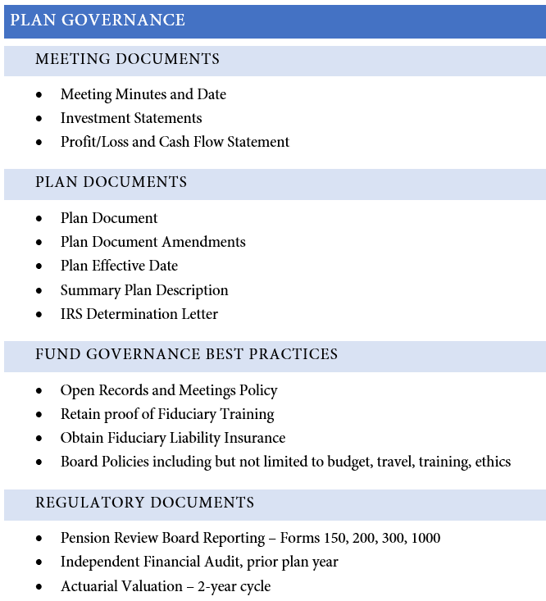
Fiduciary checklist: plan governance

Slide 9
Fiduciary checklist: investments

Slide 10
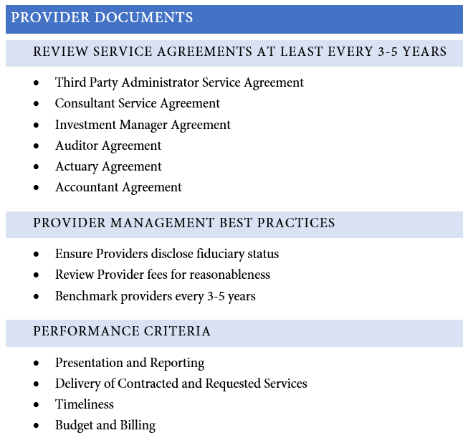
Fiduciary checklist: provider documents

Slide 11
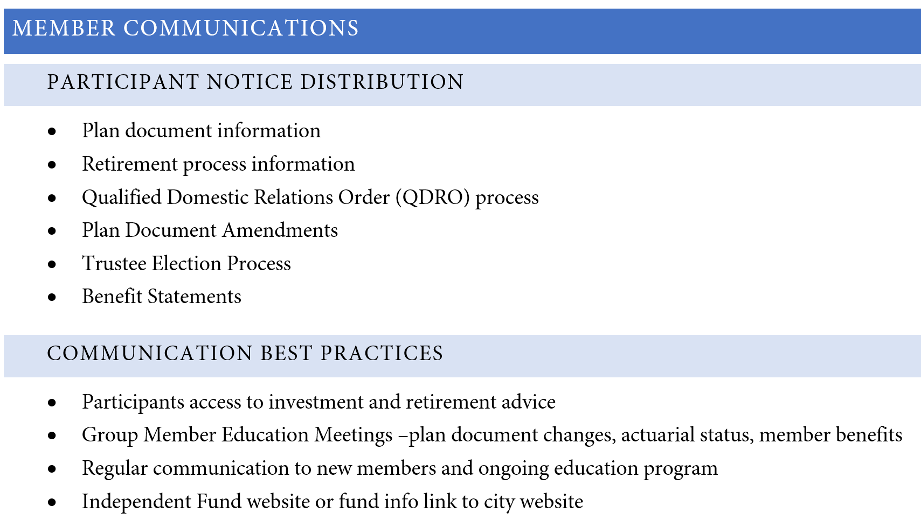
Fiduciary checklist: member communications

Slide 12
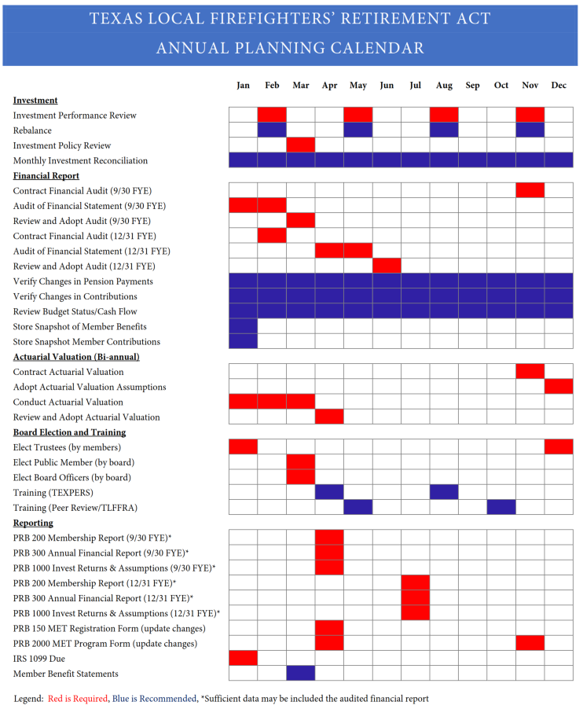
TLFFRA Annual Planning calendar

Slide 13
KEY TAKE-AWAYS
Keep contracts and service agreements up-to-date
Benchmark your fees and services to the market every few years
Retain copies of all benchmark projects
Regularly review all fees paid from fund
Administration
Consulting
Investments

Slide 14
Contact us
For more information about our firm, please visit our website, captrust.com,
Or contact us toll-free at 800.216.0645
We welcome the opportunity to design a customized program to ensure that you effectively meet your fiduciary obligations, efficiently manage your assets, and ultimately accomplish your organization’s mission.
Lisa Ivie Miller, AIF®
Principal | Financial Advisor
115 Wild Basin Road, Suite 225
Austin, TX 78746
Lisa.Miller@captrust.com
512.342.2272 (o)
512.698.4593 (c)

